Slide 1
Airbnb Bookings Analysis

Slide 2
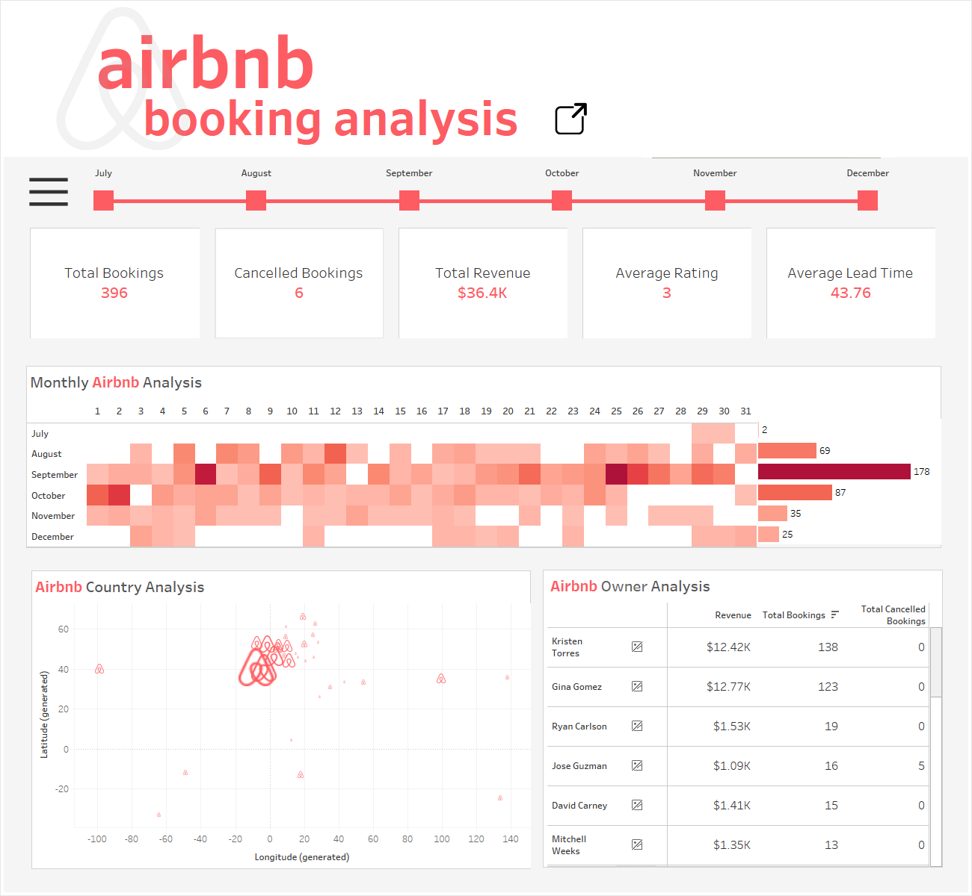

Slide 3
